Slide 1


DataBase Practice
Web Programming
Final Presentation
Team4
Nam JunNyong
Lee SungHo
Hwang JaeHun
Park JeongHa

Slide 2
INDEX
01. Data Storage & Processing
02. Data Analysis
03. Web Programming & Database
04. Conclusion
Pre-processing use MySQL
How to use MySQL
How to use Tableau
A basic logic running homepage
Basic Homepage structure
How to show result using Mysql & Php
How to show result using Tableau & Php
A basic logic running homepage
Basic Homepage structure
How to show result using Mysql & Php
How to show result using Tableau & Php

Slide 3

01
Basic Idea – Datasets
Air traffic data produced at domestic airports
from January 2017 to June 2019. (total : 987,709)

Slide 4
01
Basic Idea – Final target
We are going to analyze airplane delays according to Various factors
such as airports, airlines and delay reasons based on the past flight data.
And show the probability and information of delays based on the analysis.

Slide 5
01
Basic Idea – Final target
Motivation
Continuously increasing demand for air traffic services has also increased inconvenience to passengers due to delays and cancellations of aircraft.
Expected Effect through this service
1. Increase user benefit by showing previous flight data more intuitively and efficiently.
2. Help airlines and airports become more efficient and cost-effective.

Slide 6




02
System overview and architecture
MySQL
Database used
for web service
Tableau
Data visualization
PHP, AJAX
Web service

Slide 7
03
Detailed Processes and Functionalities
1. Process the initial data table using MySQL.
2. Using MySQL, test all data table and connect with Tableau
3. The data are visualized through Tableau.
4. The results are shown in the form of bulletin boards in Web services created
using PHP and AJAX.
5. The web service also provide fields to type seasons, hours, airlines, airports,
etc., and show the probability of delays and cancellations based on entered
information.

Slide 8
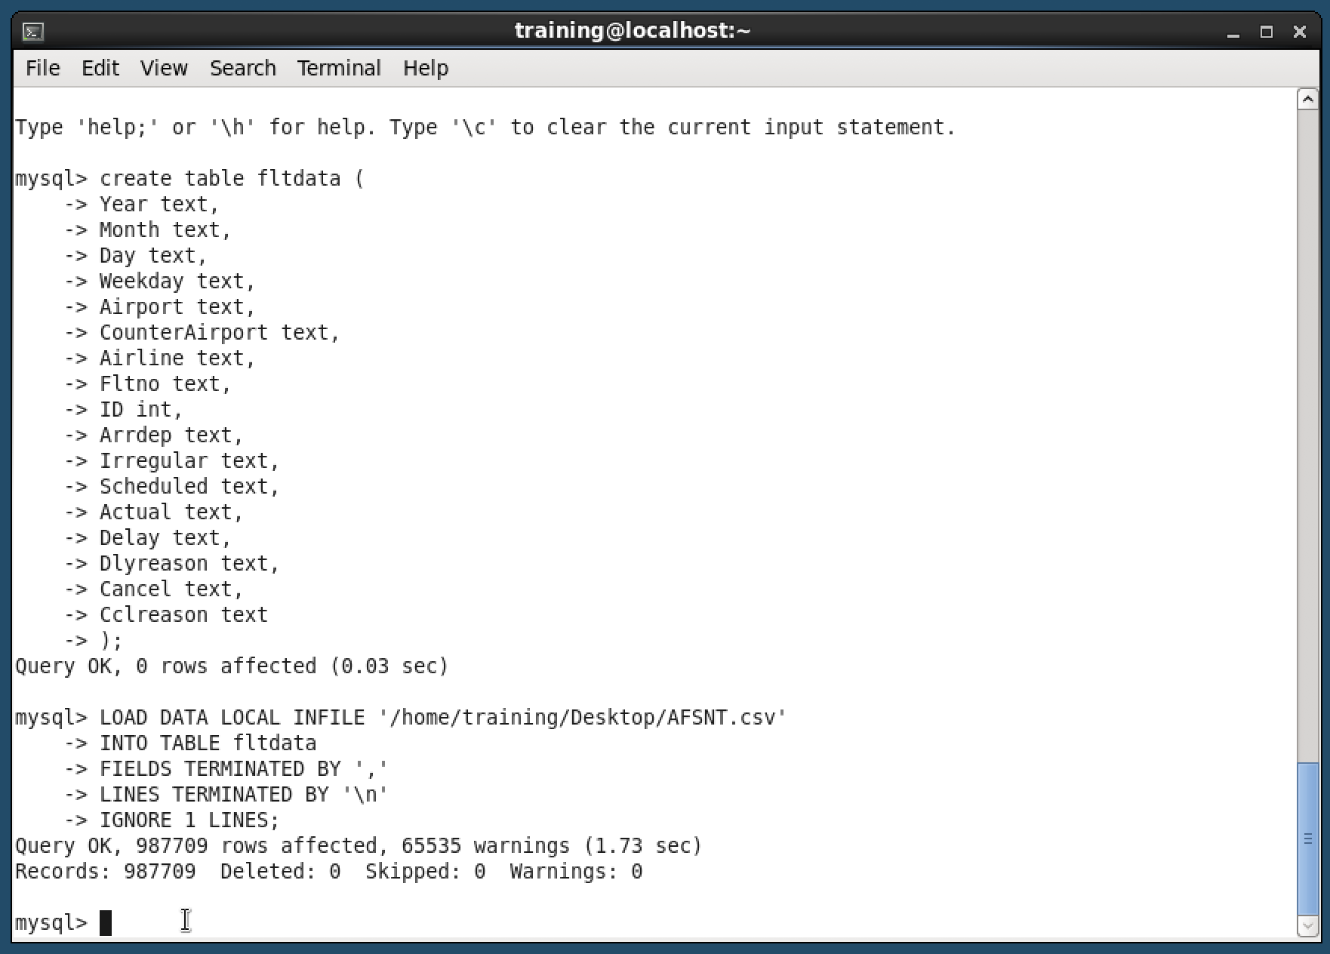
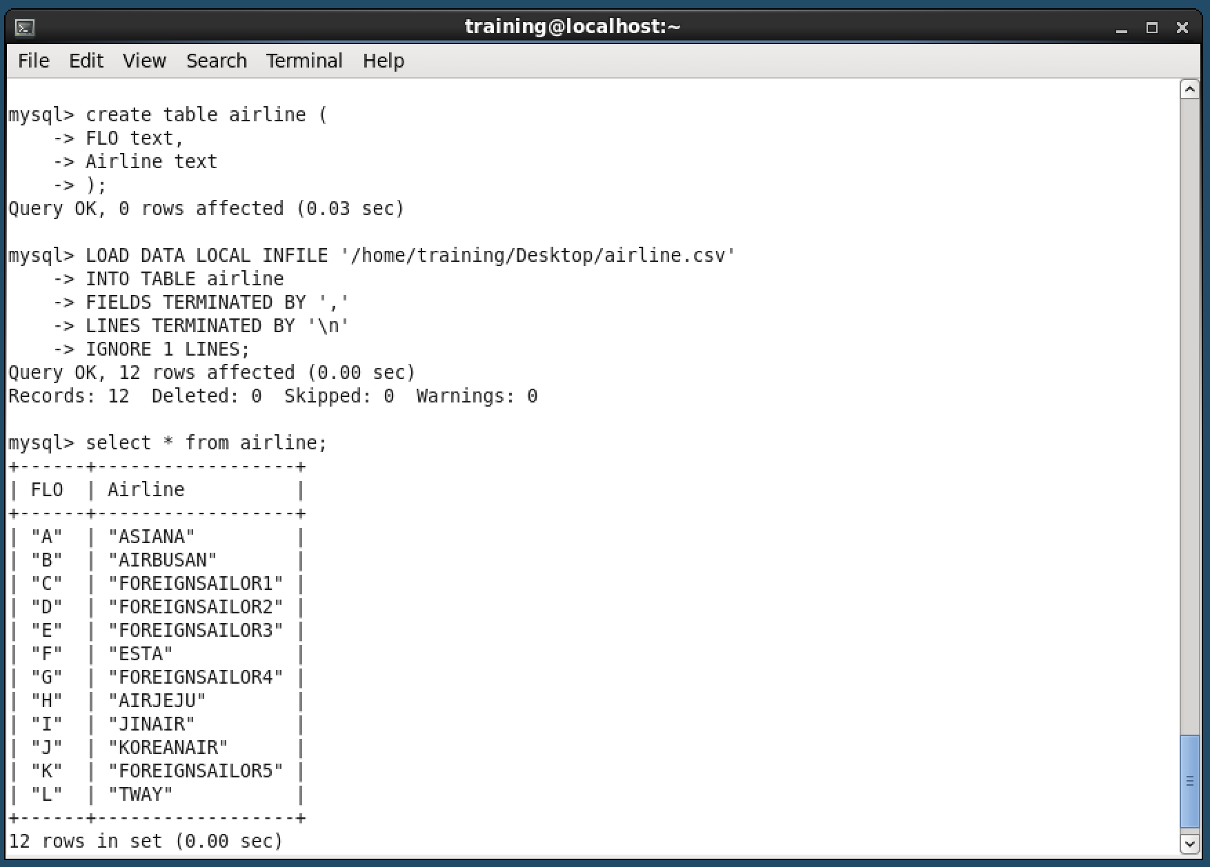
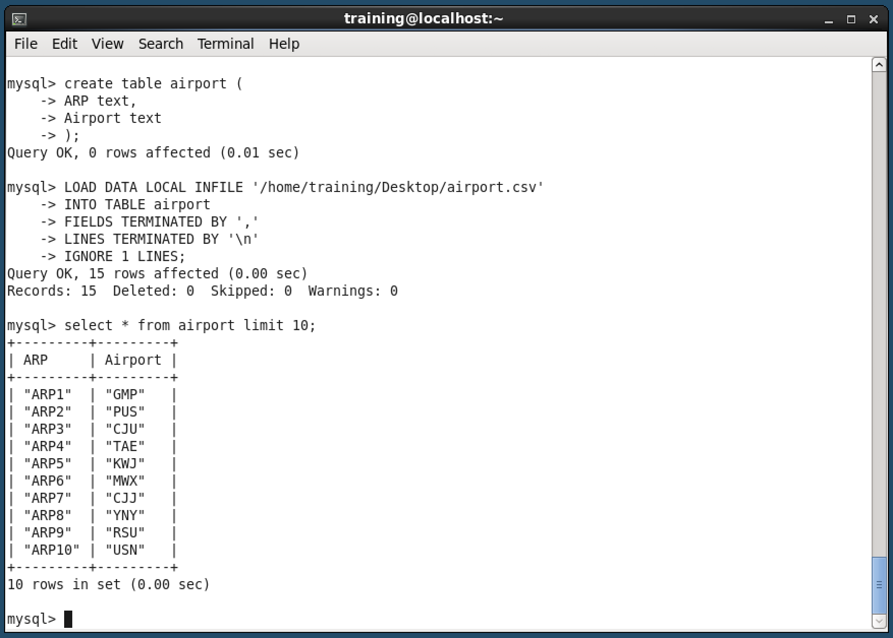
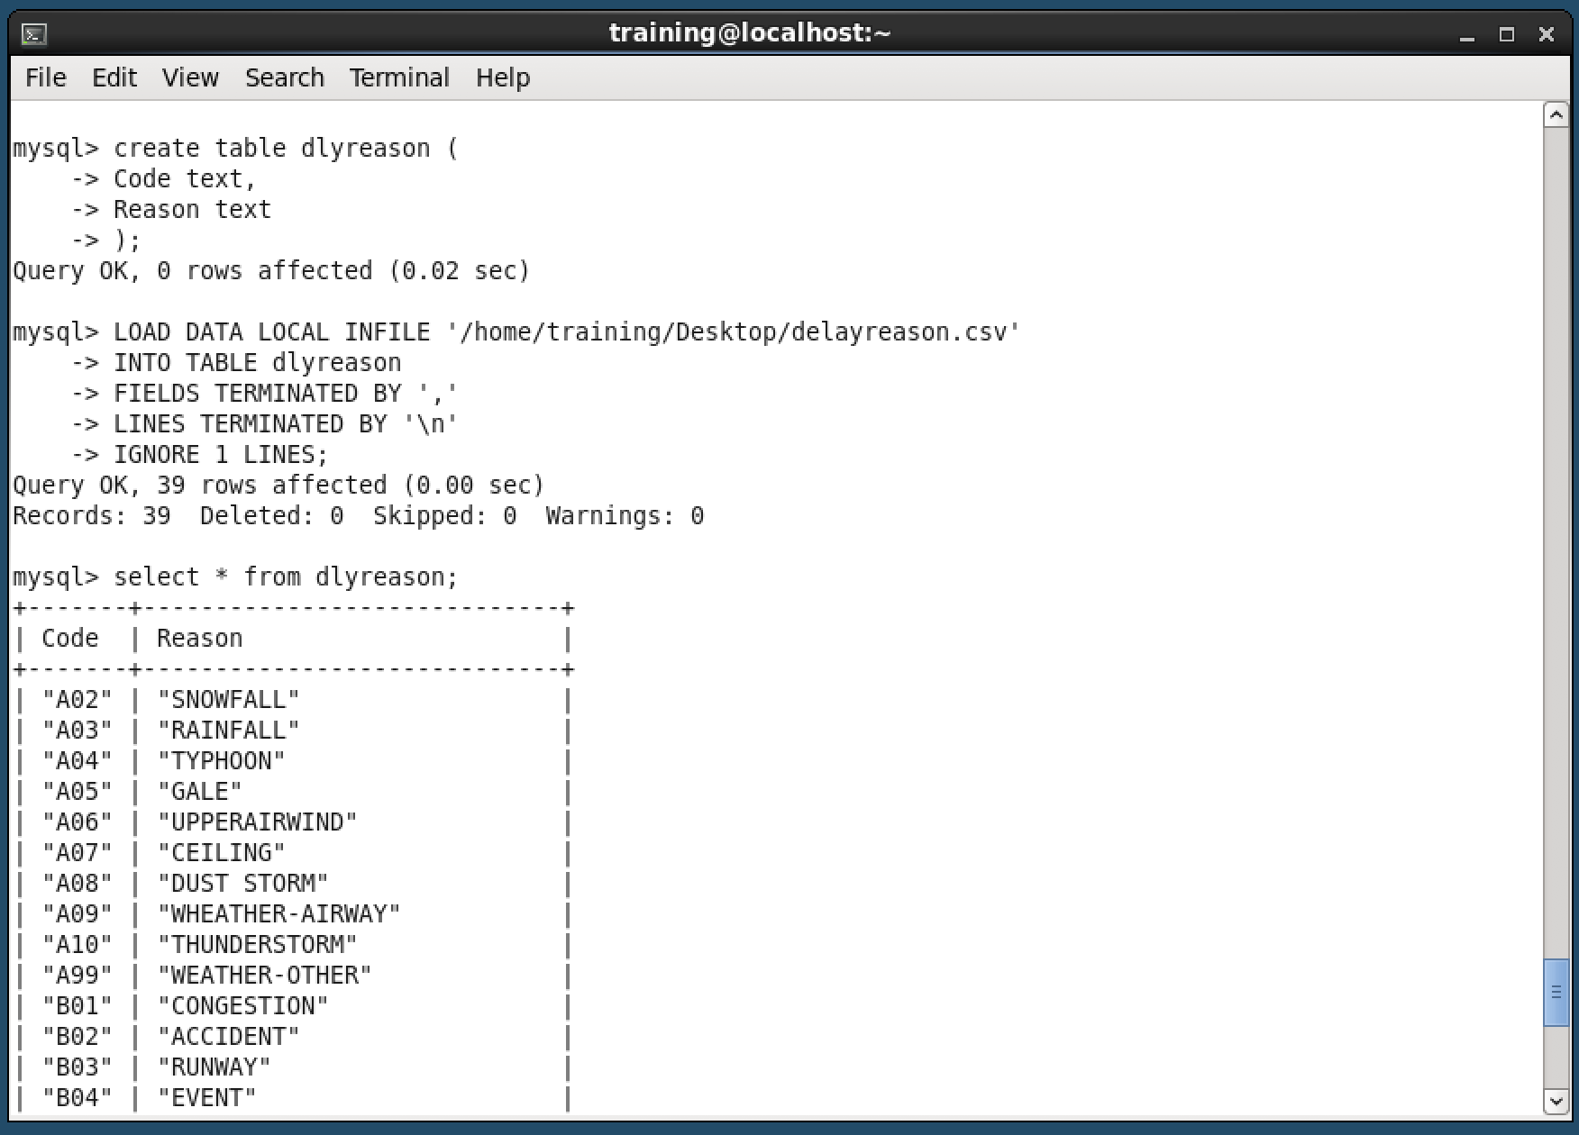
10
Data Storage and Processing
First, we put a data using MySQL ‘AFSNT.csv’, which is a collection of domestic flight data from January 1, 2017 to June 30, 2019. And ‘airport.csv’, which shows a relationship between virtual airport name and real name name, ‘airline.csv‘ , which shows a relationship between virtual airline name and real name. Lastly, ‘delayreason.csv’, which shows a translation code to real delay reason like weather, runway problem etc.
<AFSNT.csv>
<airline.csv>
<airport.csv>
<delayreason.csv>

Slide 9

20
Data Analysis
We use ‘join’ method to combine more than two tables.
We make a new columns to analysis data, ‘Datetime’ , ‘Schedule time’, ‘Origin’ , etc.
We save the processed data using MySql server.
We use tableau for analyzing data and showing data visualization.

Slide 10
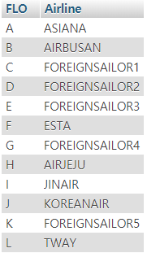
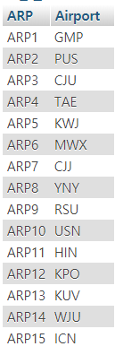
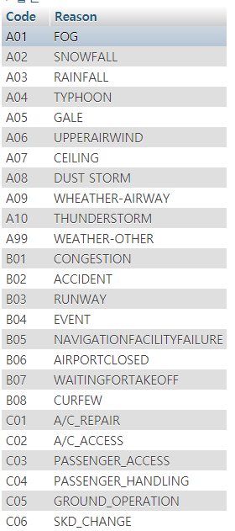
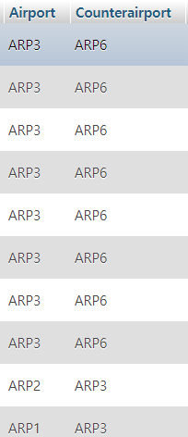
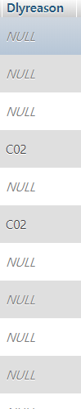
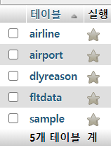
21
How to use MySQL
We tried to analyze the original flight data by identifying number of delays caused by various factor (annual, seasonal, monthly, day of the week, time, delays by Delay Code). First, we changed the data’s columns(Airport, Airline, Delay reasons) that recognized easily using, casting columns.
<table airline>
<table airport>
<table delayreason>
<table fltdata>

Slide 11
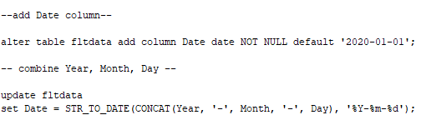
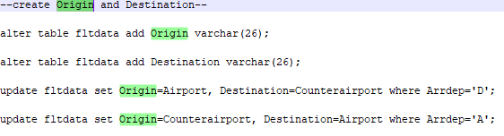
21
How to use MySQL
Second, we make a new columns
‘Date’ : Merge ‘Year’, ‘Month’ , ‘Day’ columns and change data type ‘Datetime’ for calculating
‘Origin’ & ‘Destination’ : The original data is a mix of departure and arrival airports. So we separate these data to recognize easily.
<create date columns>
<create origin & destination columns>

Slide 12
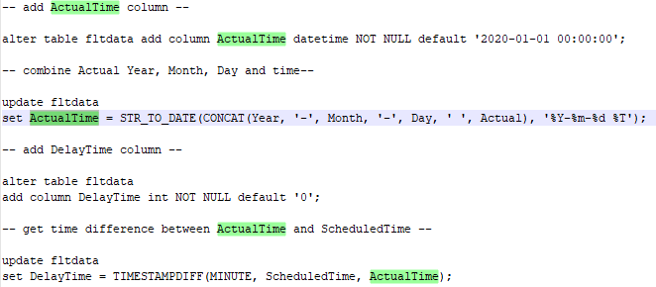
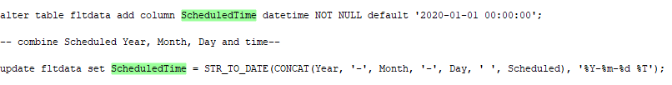
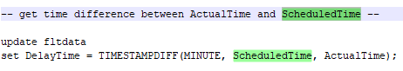
21
How to use MySQL
‘Scheduled Time’ : Using ‘Origin’ & ‘Destination’ , we remake scheduled time at ‘scheduled’ to calculate finding out how late it was.
‘Actual Time’ : Using ‘Origin’ & ‘Destination’ , we remake scheduled time at ‘scheduled’ to calculate finding out how late it was.
<create Scheduled Time columns>
<create Actual Time columns>

Slide 13
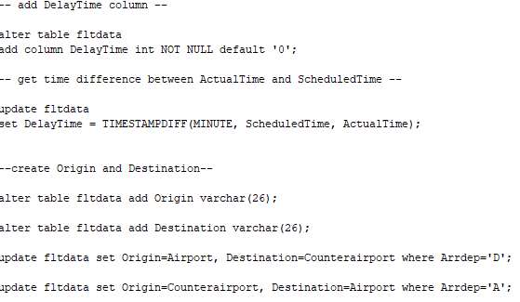
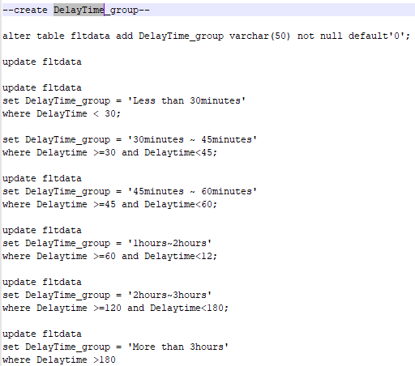
21
How to use MySQL
‘Delay Time’ : Using difference time of ‘Scheduled time’ and ‘Actual time’, we calculate how long the flight has been delayed to identify intuitively.
‘Delay Time Group’ : Make a group of delay time ‘0 ~ 30mins’ , ‘30 ~ 60mins’ , ‘1~2hours’, etc, to show how serious the delay is.
<create delaytime columns>
<create delaytime group columns>

Slide 14
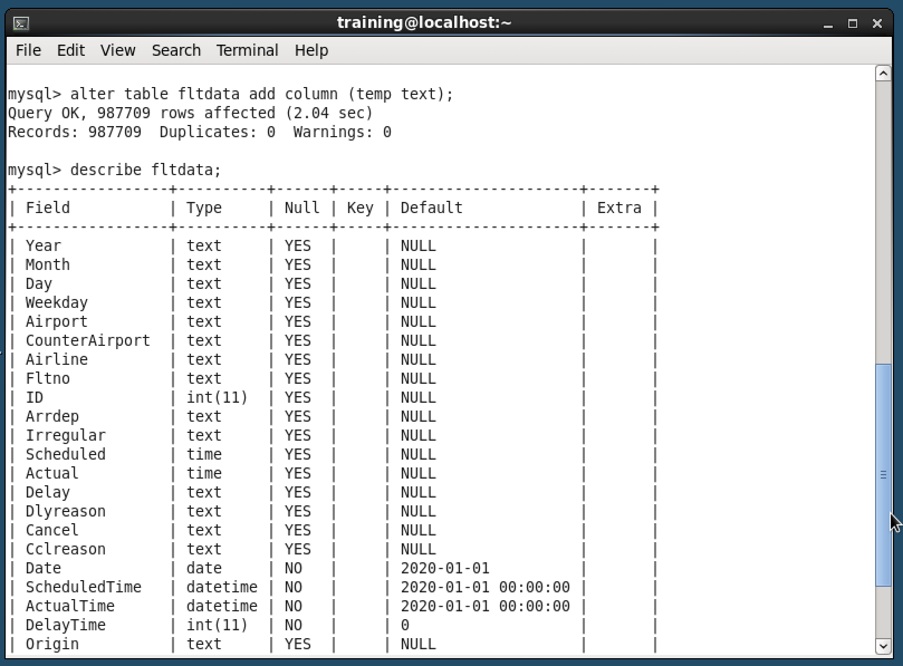
21
How to use MySQL
Result for query
<result database table>

Slide 15
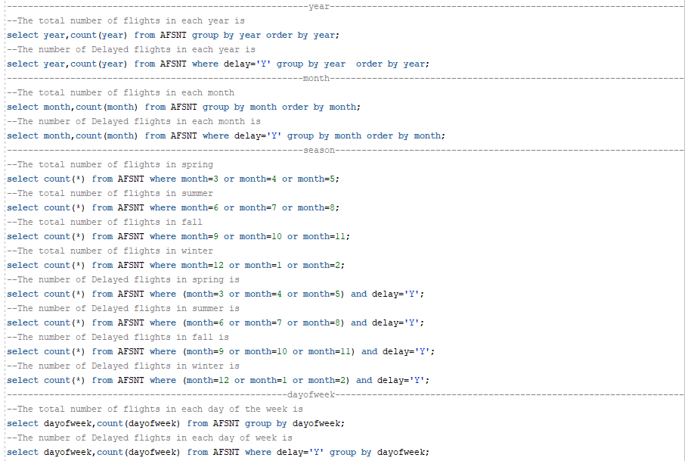
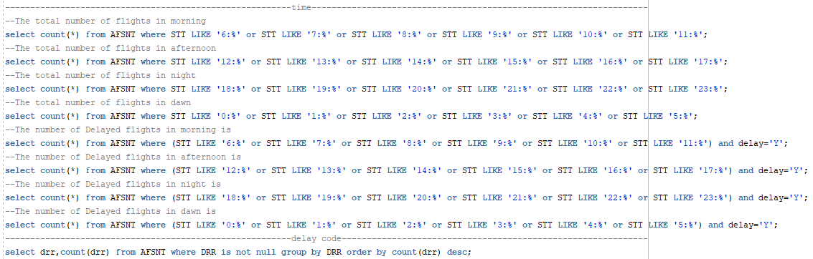
22
How to use Tableau
We made several SQL query statements to analyze and visualize the data as we did earlier. For example, we created seasonal delay rates, time-to-time delay rates, and so on, etc. But we've come to use 'tableau' for 'better' data visualization than using php and JavaScript!

Slide 16
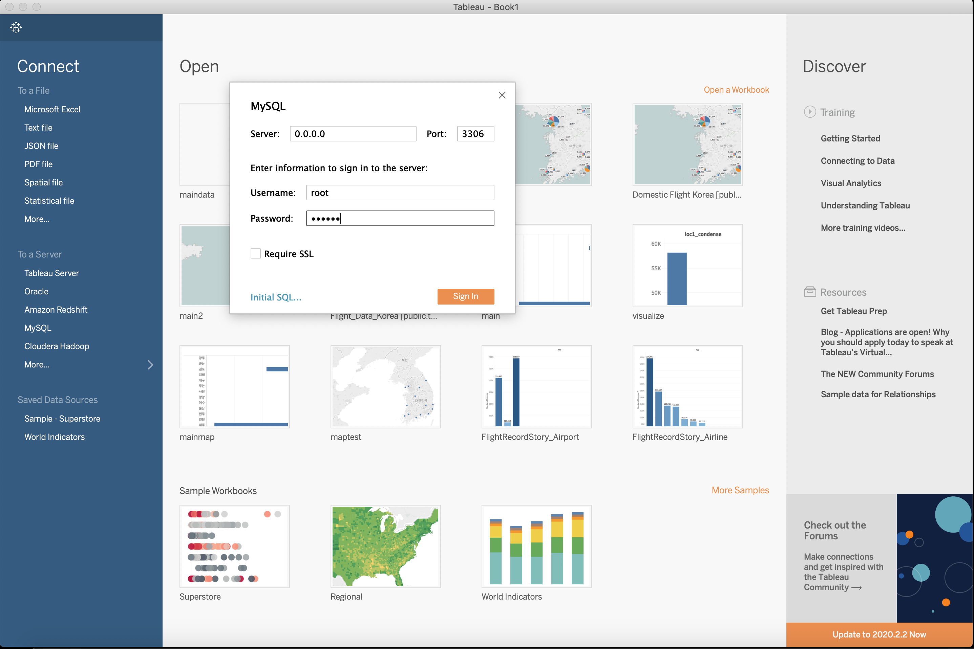
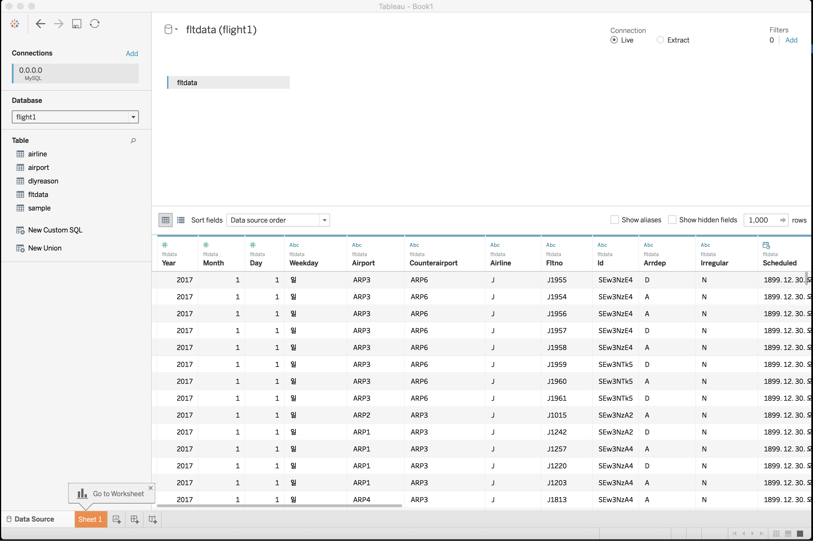
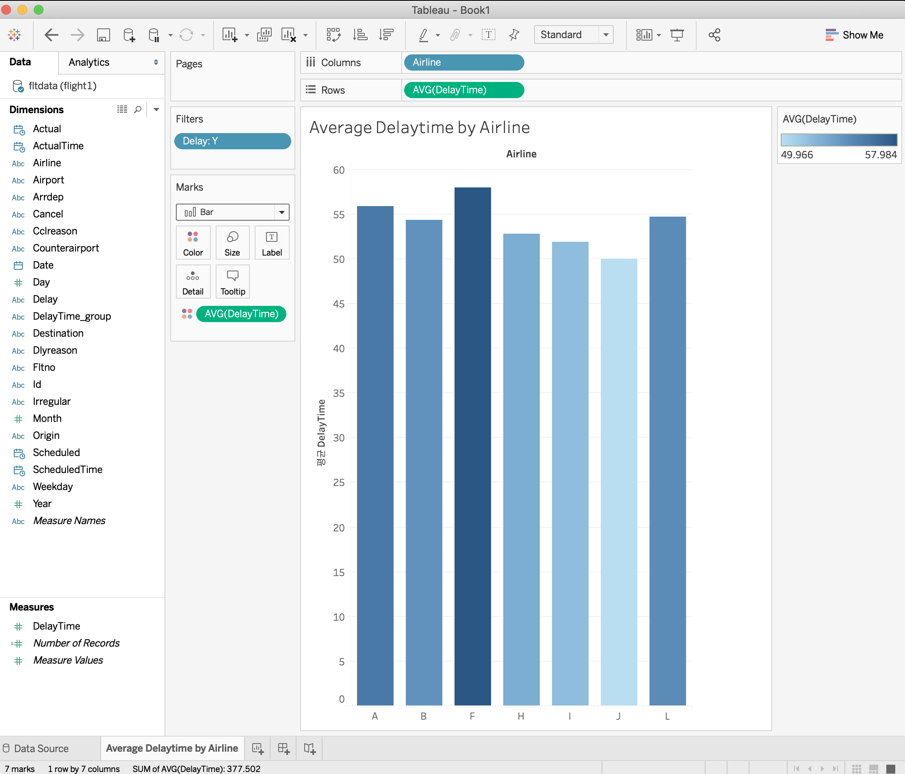
22
How to use Tableau
First, we link MySQL and Tableau for visualization. So we can use pre-processed database before pages.
And we can make graph like under picture using MySQL database.

Slide 17


30
Web Programming & Database
To show the result of delay, we make web pages which get user data, communicate input data using php and ajax, and show result by connecting MySQL database.
To show our analyzed data and visualization using tableau, we make web pages and interlink Php and Tableau with analysis by categories.

Slide 18
31
A basic logic how to run homepage
getday.php
flightno.php
getdest.php
Call using ajax
Showing result ‘delay rate’ , ‘estimated delay time’ , table of the number of delays by delay time group etc, using post ‘index.php’ and runnig query.
Click ‘Go to search’ button
index.php
Platform that connects various homepage
Input data and hand over these data that will be use to query at ‘flightno.php’
airline.php
Click ‘Go to xxxx’ button
Click ‘Statistics’ and next one at navigation bar in the main homepage’s upper right corner
delayreason.php
airport.php

Slide 19
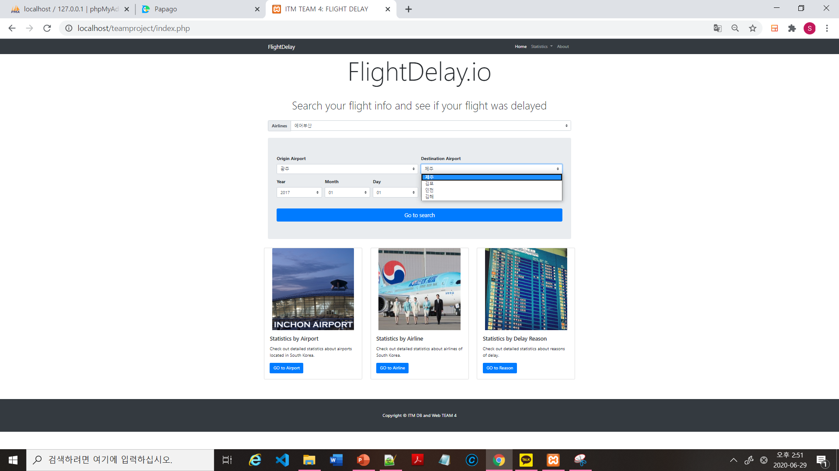
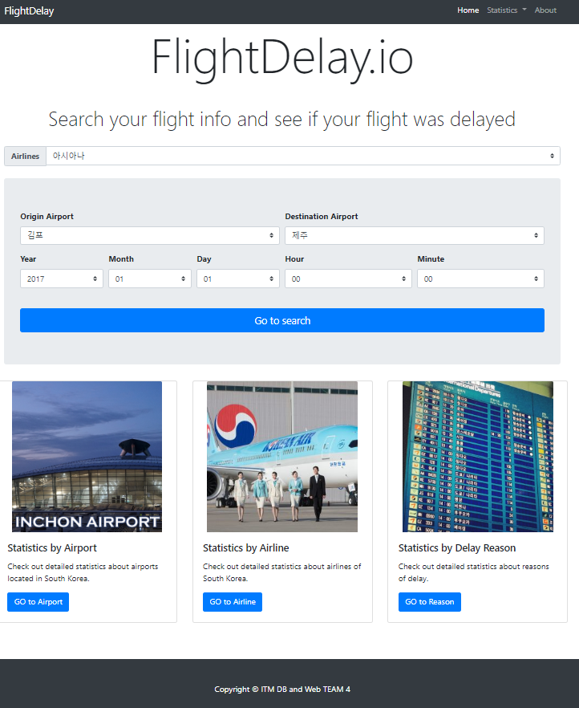
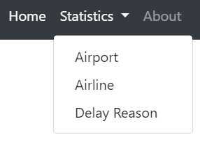
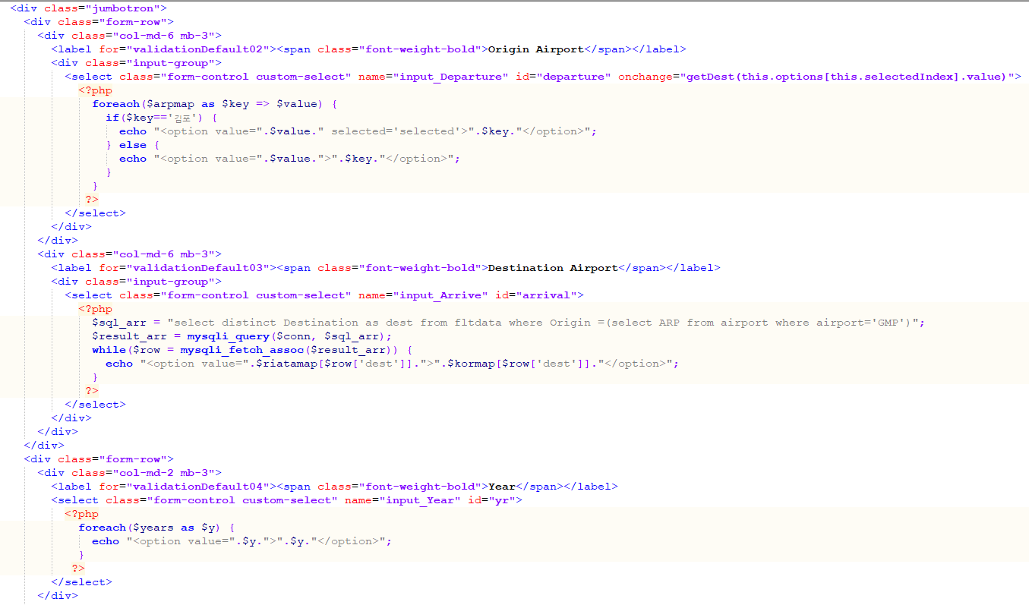
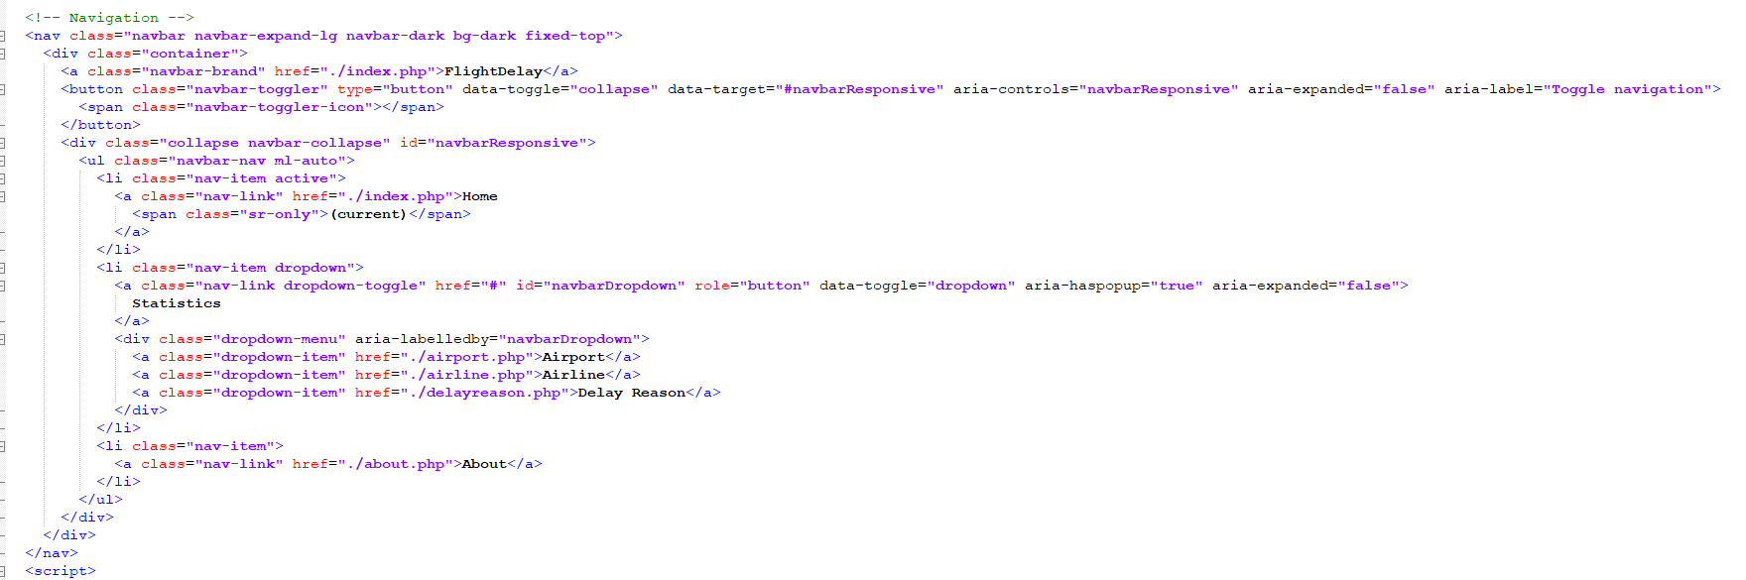
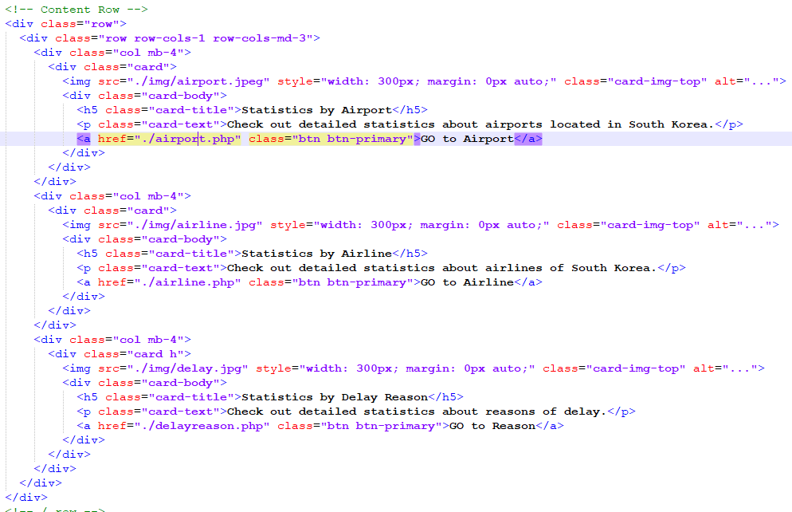
32
Basic Homepage Structure
index.php
We make input box to input users flight data and send to flightno.php for using sql queries
We make navigation bar which is clicked, homepage is moved what you want
We make buttons which is clicked, homepage is moved what you want

Slide 20
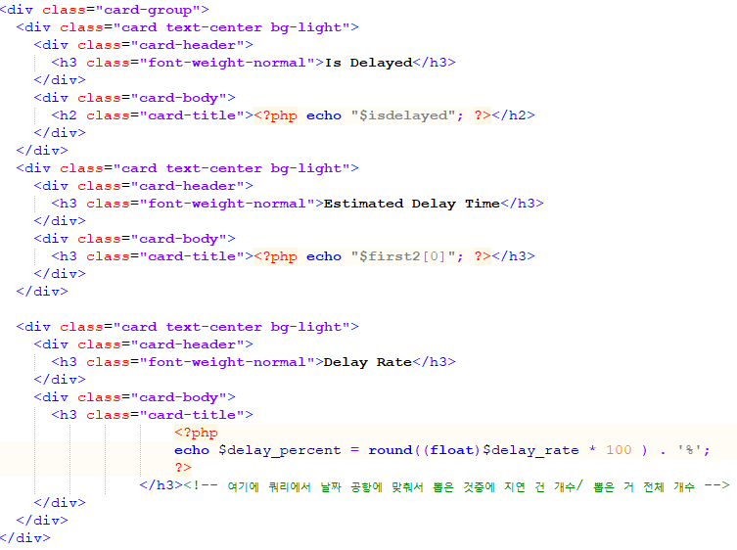
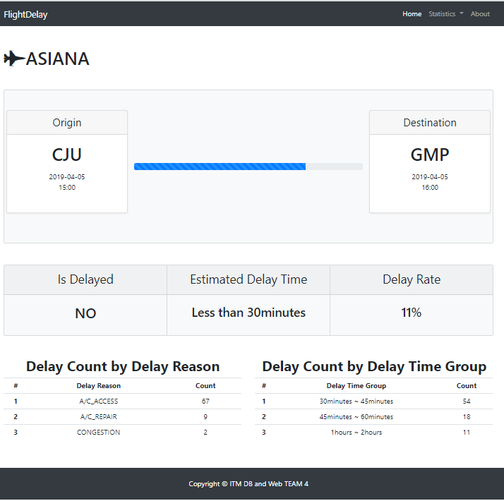
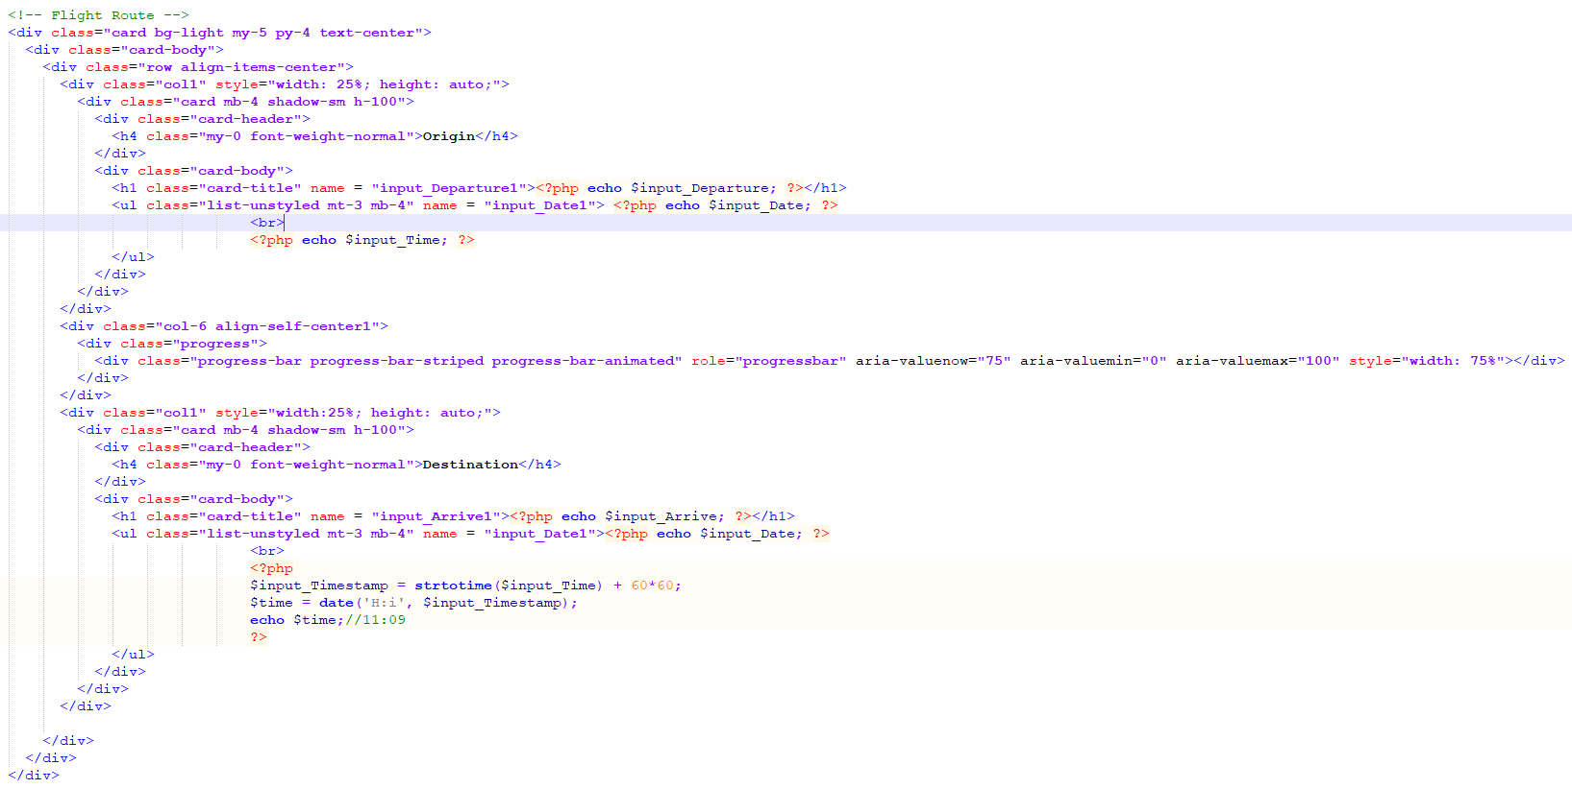
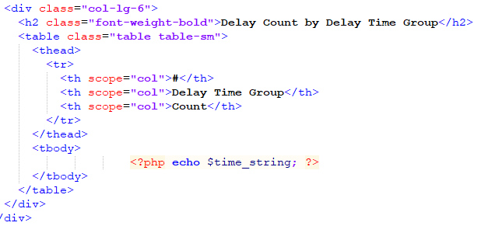
32
Basic Homepage Structure
flightno.php
We make a box which is showed received data at ‘index.php’
We make a box which is showed result of SQL queries to count the number of columns in conformity with queries and calculate delay rate.
We make a box which is showed result of SQL queries the top 3 reasons and time group

Slide 21
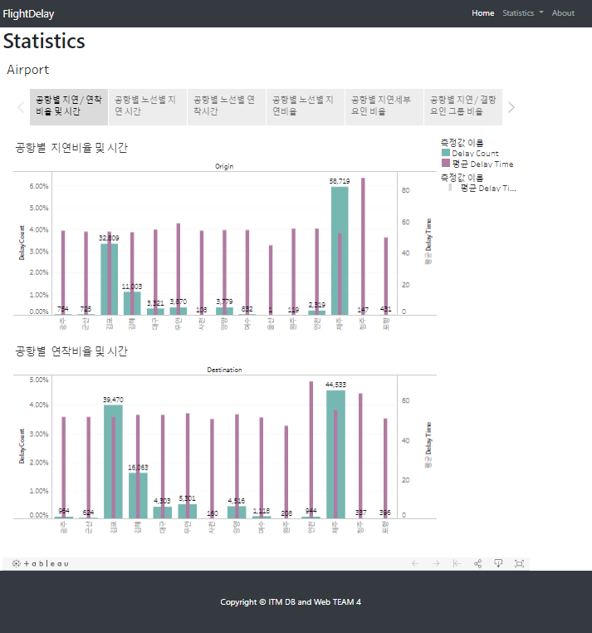
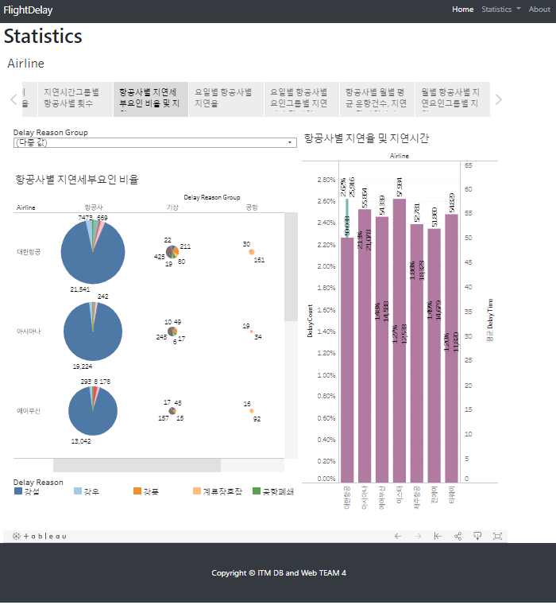
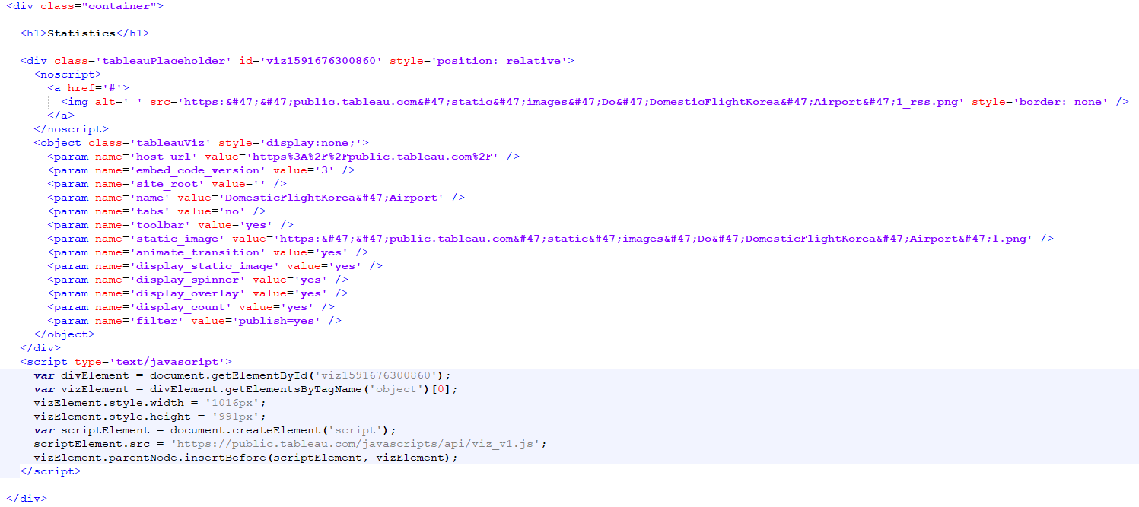
32
Basic Homepage Structure
airline.php & airport.php & delayreason.php
: We make basic homepage to link homepage and Hadoop-Tableau, and show analyzed result

Slide 22
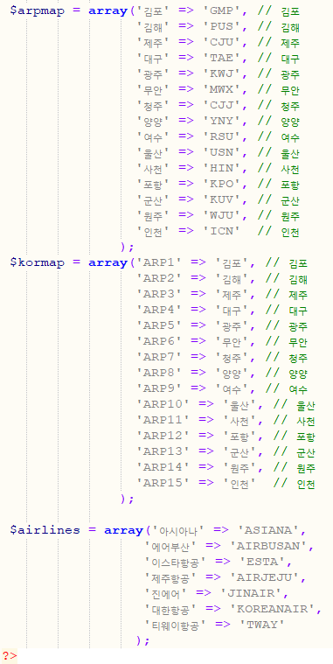
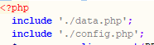
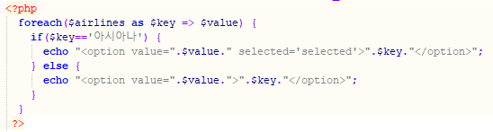
33
How to show result using MySQL & php
We create ‘data.php’ to show database’s airport & airline column data we know easily at ‘index.php’
<data.php>
<index.php>

Slide 23
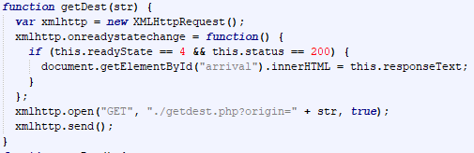
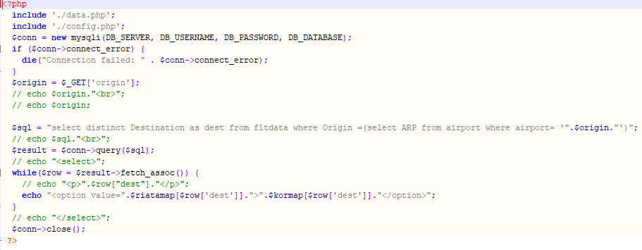
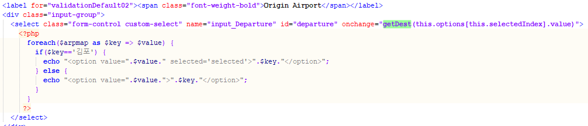

33
How to show result using MySQL & php
We used the ajax program so that we could only select the airports that could go by criteria of the departure airport
<index.php>
<getdest.php>
<result>

Slide 24
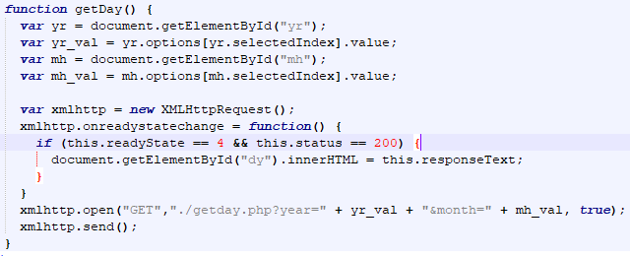
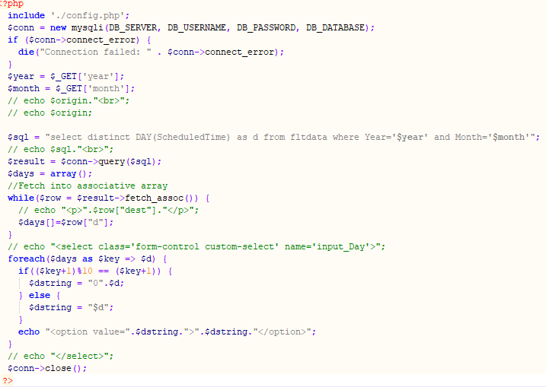
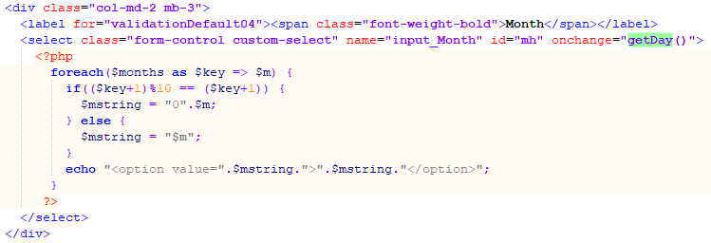
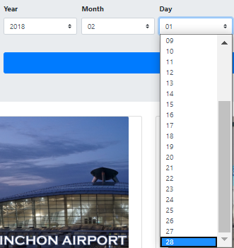
33
How to show result using MySQL & php
Likewise, we used the ajax program to make the day of the week available for selection based on the month and year entered.
<index.php>
<getday.php>
<result>

Slide 25
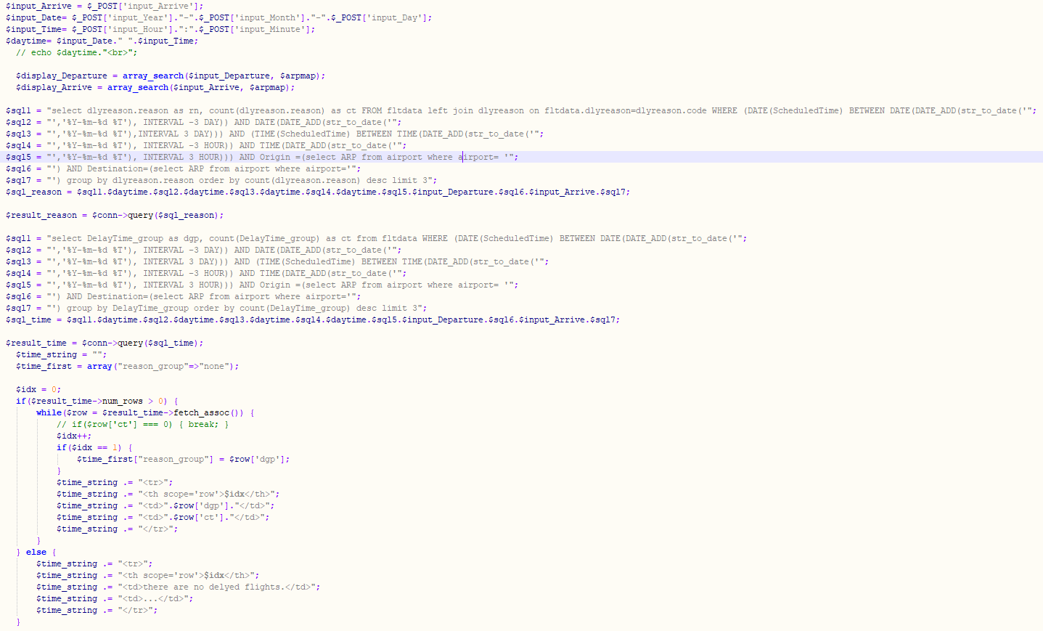
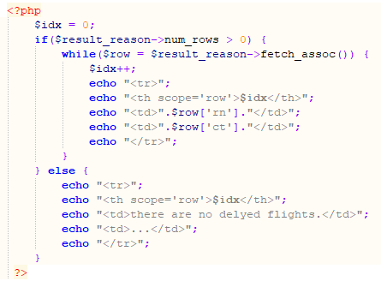
33
How to show result using MySQL & php
For based on user data received from the main page, we collect aviation data that is most similar to the aviation data user entered. In the query below, the data is searched in the database for about three days and three times after matching the entered date with the 'datetime' type variable.
<code for printing result at table>
<Code for making data table satisfied with the conditions>

Slide 26
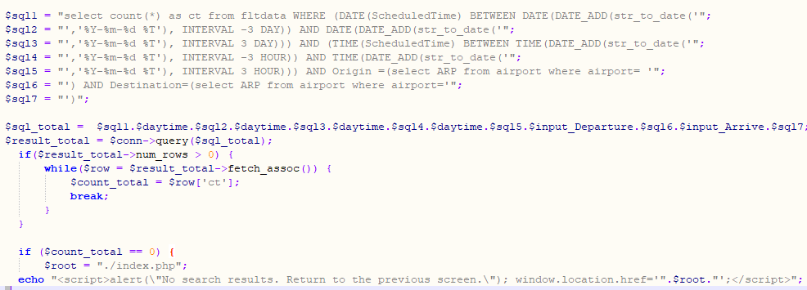
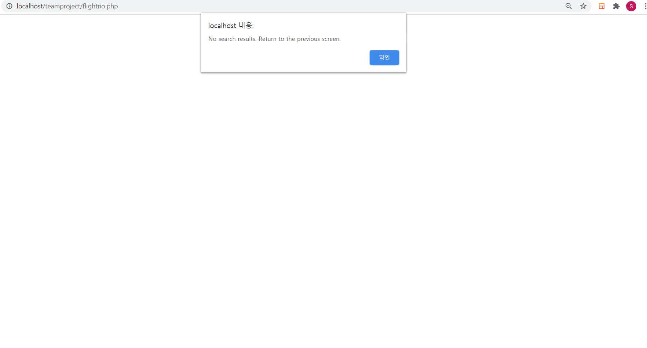
33
How to show result using MySQL & php
If there is no data generated through the previously executed query, we notify user that the data is not being viewed and send it back to the main homepage to enter the data again.
<flightno.php>
<result>

Slide 27


33
How to show result using MySQL & php
If there is a data at generated through the previously executed query, we count the number of delay column is yes, and count group of time bound. For these, we calculate rate of delay, which the number of delay upper 30 minutes divide total number and print top 3 of delay reason and delay time group.
<code for pre-work>
<code for printing result at box>

Slide 28


33
How to show result using MySQL & php
And these are the results of query that I explained earlier. This is the result of ‘김해‘ to ‘제주’ at 04/05/2018 3pm.
<result of page-26>
<result of page-24>

Slide 29

34
How to show result using Tableau & php
And we show visualizations of data using Tableau in front of pages, through 'airline.php’ , ‘airport.php’ , ‘delayreason.php’. For these, we upload visualizations ‘Tableau public server’ and call up the saved contents and show them on our homepage.

Slide 30


34
How to show result using Tableau & php
‘airport.php’
<Delay Ratio and Time by Airport>
<Delay Ratio and Time by Airport’s Airline>

Slide 31


34
How to show result using Tableau & php
‘airport.php’
<Delayed arrival Ratio and Time by Airport Airline>
<Delay Ratio by route by airport>

Slide 32


34
How to show result using Tableau & php
‘airport.php’
<Delay detail factor ratio by airport>
<Percentage of Delay & Cancellation Factors Groups by Airport>

Slide 33


34
How to show result using Tableau & php
‘airline.php’
<Airline Usage Rate & Delay Rate and Time by Airline>
<Number of times by latency group per airline>

Slide 34


34
How to show result using Tableau & php
‘airline.php’
<Delay detail factor ratio by airline>
<Delay rate by airline by day & time zone>

Slide 35


34
How to show result using Tableau & php
‘airline.php’
<Delay detail factor ratio by airline>
<Monthly Related Airline Delay Analysis>

Slide 36

34
How to show result using Tableau & php
‘airline.php’
<Airline Comparison for Monthly Delay Groups>

Slide 37


34
How to show result using Tableau & php
‘delayreason.php’
<Delay Rate by Delay Detail Factor & Delay Time by Monthly Detail Factor>

Slide 38
40
Conclusion
The steps of analyzing the problems and debugging them
Main function of our service
Use Impala To Preprocessing
Initial target : service to predict the probability of future flight delay or cancellations based on past data
However, there were many difficulties we met.
First, cannot confirm that the input data by the user was the actual flight data. Because we cannot to get flight information from the actual flight reservation service (such as sky scanner).
Second, to predict delays of flight for a specific day, numerous factors must be considered such as weather, wind, rainfall. But it’s difficult to interconnect a lot of data.
So, we decided to get user input within our data and provide information of delay based on our analysis not prediction.
Current service can be developed into more useful service if we change the server language, build predictive models, and link more data together.
put original file from local to hdfs using sqoop
And try to preprocess the table using impala alter table, update set commands.
However, the update set command was only supported in Impala 2.8 or higher versions, while the impala in our Cloudera environment was 2.2.0 version.
So, we tried various solutions such as updating Impala and installing the cloudera trial version.
But it was hard to achieve.
Second, Impala does not support datetime data types, but our main parts of preprocessing are the calculation and merging of date and time. (See next slide picture.)
In the process of importing the table to hdfs through sqoop, errors were occurred because the date data was not recognized in table. (See next slide picture.)
Therefore, we use mysql for both data preprocessing and executing query.

Slide 39

40
Conclusion
Import table from local to hdfs using sqoop

Slide 40


40
Conclusion
Update statement and date type does not work in Impala

Slide 41




40
Conclusion
Comparing the result of executing query of mysql and impala after importing by sqoop).

Slide 42
Thank you

